Slide 1
What is Big Data? How Big a Data must be in order to be qualified as Big Data?
Big data is a term used to describe the voluminous amount of unstructured and semi-structured data a company creates.
Data that would take too much time and cost too much money to load into a relational database for analysis.
Big data doesn't refer to any specific quantity, the term is often used when speaking about petabytes and exabytes of data.

Slide 2
Some Examples Of Big Data.
The New York Stock Exchange generates about one terabyte of new trade data per day.
Facebook hosts approximately 10 billion photos, taking up one petabyte of storage.
Ancestry.com, the genealogy site, stores around 2.5 petabytes of data.
The Internet Archive stores around 2 petabytes of data, and is growing at a rate of 20 terabytes per month.
The Large Hadron Collider near Geneva, Switzerland, produces about 15 petabytes of data per year.

Slide 3
HADOOP TECHNOLOGY
What is Hadoop Technology??
•The most well known technology used for Big Data is
Hadoop.
•It is actually a large scale batch data processing system

Slide 4
How Hadoop Solves This Problem?
It is made to tackle huge data.
It ensures data loss by replication of data on atleast 3 machines.
It distributes the data among several machines making it easier to get results.
Cost effective, it is virtually free.
Open source: Anyone can customize Hadoop as per need and also there’s a scope for betterment of technology as well.

Slide 5
Why Not RDBMS For Storing Big Data
Cost and Purchasing.
Format (Unstructured/ Semi-Unstructured Data) .
Big Data is too big for a single machine to handle.
Till the technology is not upgrading, our sources are confined. We have a limited bandwidth (speed) but we have huge data to be processed. So to cope with the situation, we need multi- machines(parallel computing ) and distributed system is the only solution available so far!

Slide 6
Comparison
Hadoop
Rdbms
Good at tackling big data.
Dynamic schema(Distribution).
Batch system.(Don’t expect queries in mili seconds).
Analysis takes time.
Good at tackling small data.
Static schema.
Batch and interactive. Processes queries faster.
Read/Write operations are time effective.

Slide 7
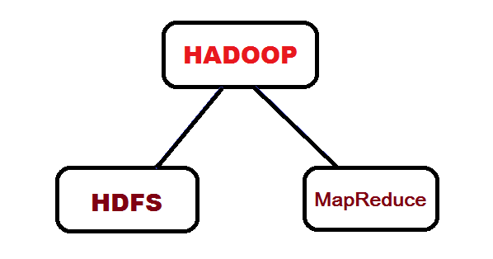
What Hadoop is Made Of?

Slide 8
HDFS
Hdfs stands for Hadoop Distributed File System.
It is actually the software component of Hadoop.
It is the brain of Hadoop systems which takes care of:
Clusters.
Nodes.
Replication of data into nodes.
Scaling.
It supports concept of blocks.
It tracks every hardware related functionality and keeps track of data replication, losses of data,etc.

Slide 9
What is block system?
The minimum amount of memory upon which a computer works is known as block.
It can be alternatively seen as the minimum size of memory that is to be allocated to a process. Eg(explain).
The block size of Hadoop system is 256 mb.
The larger the block size, the faster is the processing as blocks are allocated contiguously in array fashion which makes data writing/reading fast.
Wastage of memory is ensured by hdfs. Though it has a block size of 256 mb but actual memory allocation depends on native os. Means if the native os has a block size of 4mb, then it will allocate 64 blocks of memory to hdfs and if the file is small enough then the memory allocated can be taken back by os.

Slide 10
Clusters and Nodes
Hdfs supports multiple computer systems. The number of computers working together in a connected network is called a Cluster. There can be many clusters as well.
Every working computer inside a cluster is known as Node. The node can be of two types:
Master Node.
Slave node.
Master node is the primary node (brain node). Every cluster in a Hadoop system has a master node.
Slave nodes are the working nodes. They are used for processing. A cluster can have several slave nodes working together.
Cont…..

Slide 11
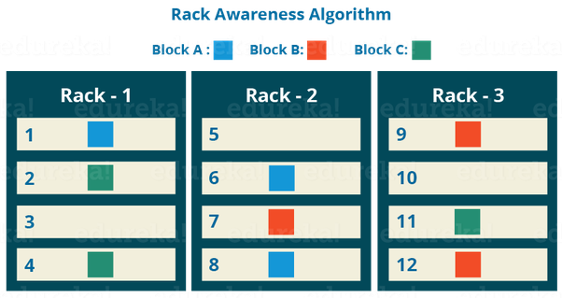
Data Replication in Hadoop
Data Replication refers to duplication of data.
Hdfs replicates the data onto atleast 3 machines and keeps track of them.
The advantage of data replication is that in case of machine failure, we can still get the result.

Slide 12
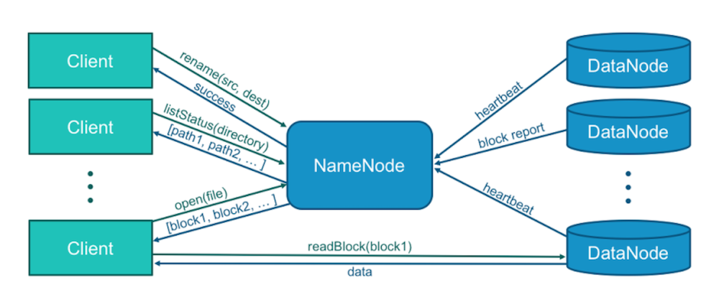
Scaling in Hadoop
1. The ability of Hadoop to add/ delete nodes from a cluster is known as scaling.Hadoop supports dynamic scaling.
2. The scaling can be of two types:
.Upscaling : means adding new nodes to cluster.
.Downscaling: means deletion of nodes from a cluster.

Slide 13
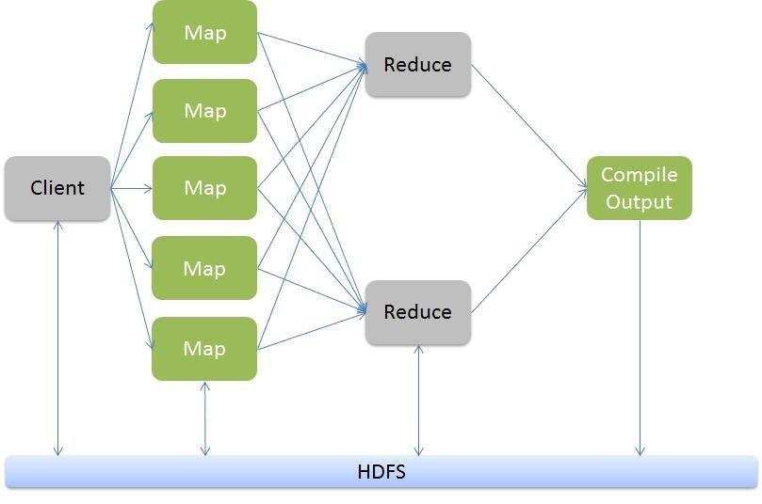
MAP-REDUCE
It is distributed programming model for processing large data-sets.
It was first conceived by Google.
It is not a language but a model so it can be adopted in any language of choice.

Slide 14
Advantages of Map-Reduce
It is run for every line of the data so care is to be taken for a single line not for the entire project.
No tension for distributed system. It is the responsibility of hdfs to reduce all the mapped data.
Before merging, sorting of data is done on key basis.
Finally the datasets are merged.

Slide 15
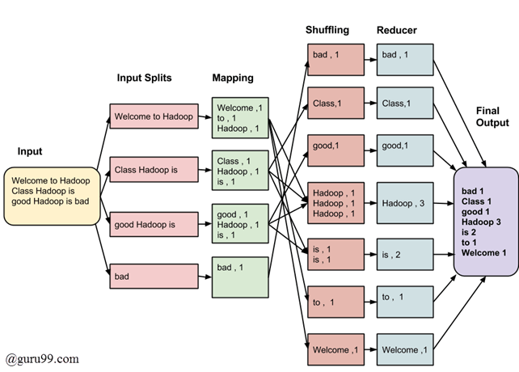
Example using Word-Count

Slide 16
Any Questions?

Slide 17
Thanks

